Slide 1
Responsible AI Workshop
Principles, Policy and Ethics in the Era of Artificial Intelligence
Anthony Franklin, PhD
Microsoft

Slide 2
AGENDA
WHY Responsible AI?
Responsible AI Principles
Responsible AI Lifecycle
Closing

Slide 3
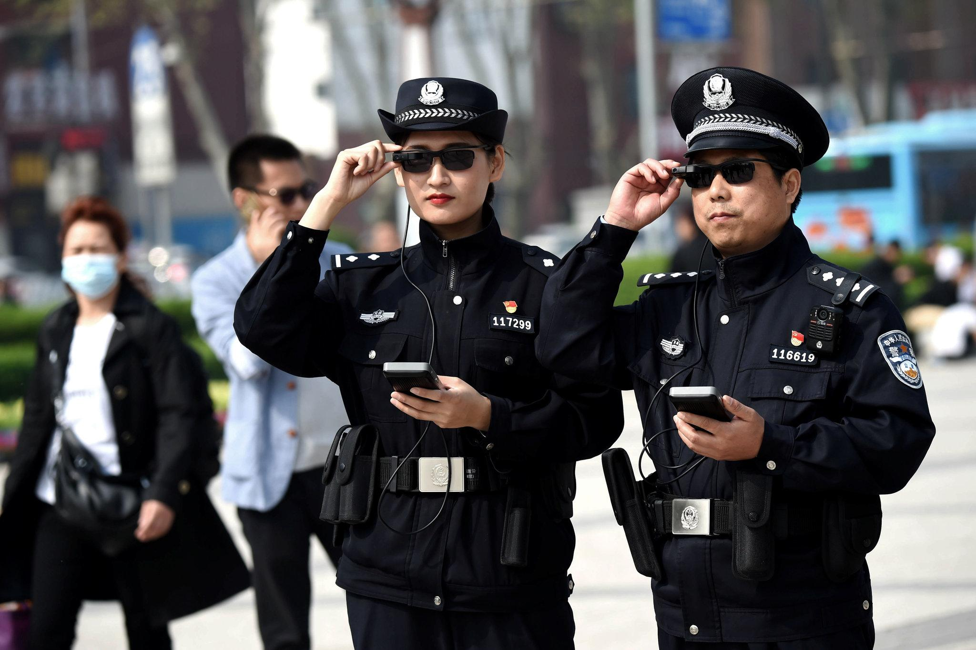
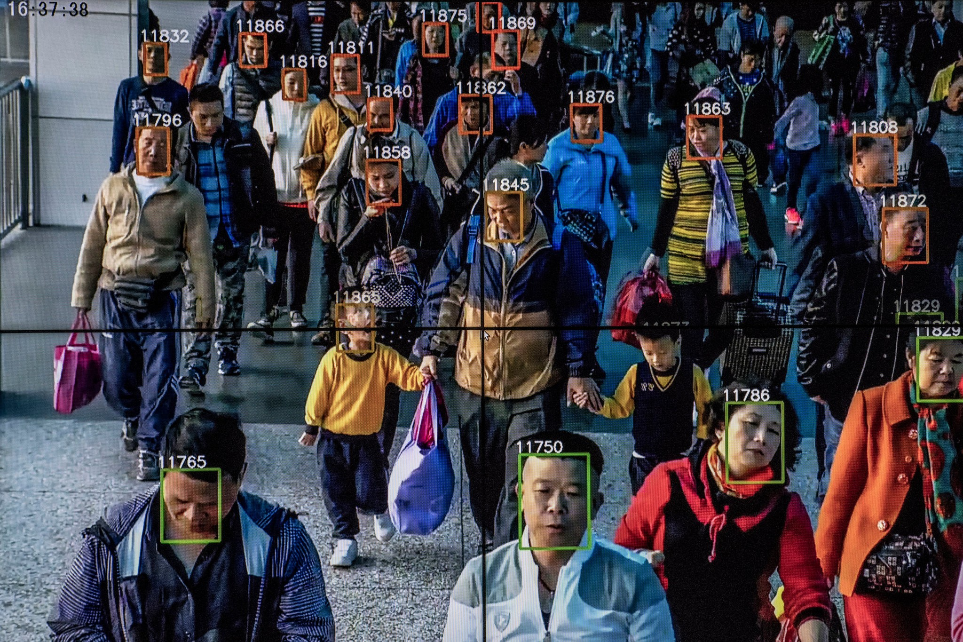
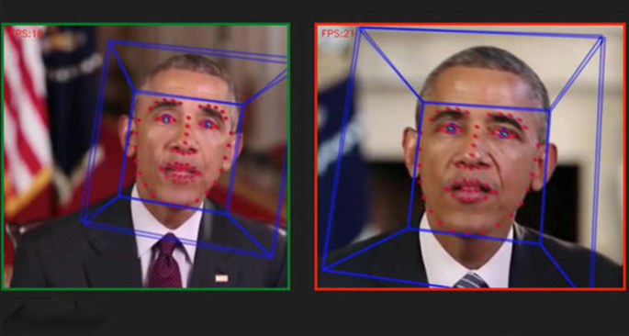
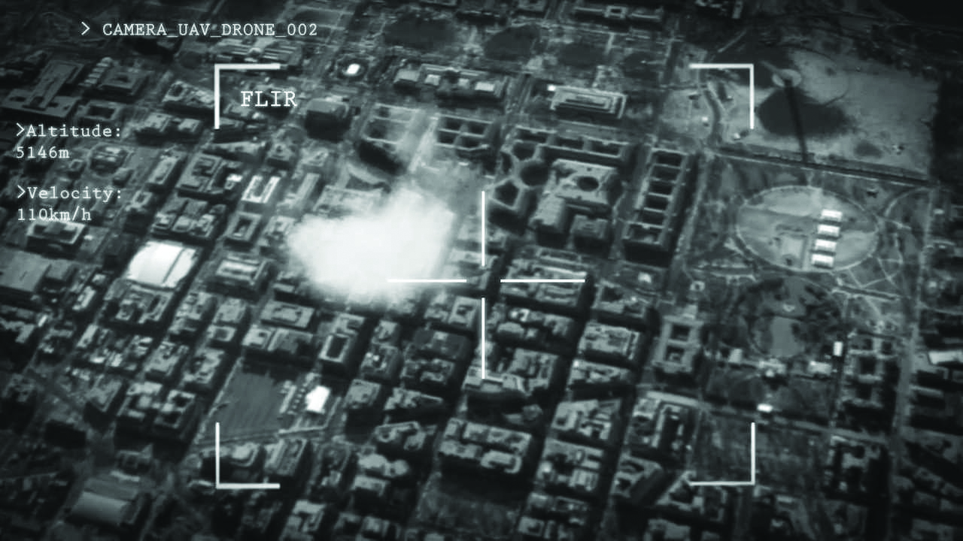
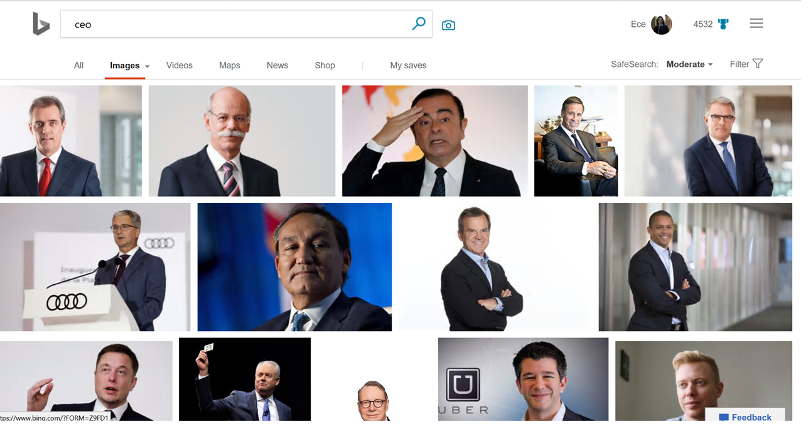
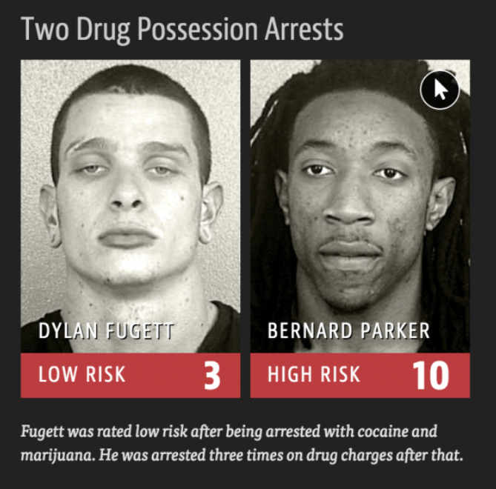
Today’s Debate
Notes:
-- OPTION A --
*dystopian/dangerous outcomes – decide on the tone required for the meeting*
##
At the same time, these rapid advances have given rise to an industry debate about how the world should/shouldn’t use these new capabilities. The purpose of this talk is to help frame this debate with a set of principles we can anchor on, and a set of actions we can all take to advance the promise of AI in ways that don’t cause harm to people.
#
AI glasses in China
AI-driven targeting systems for drone platforms
White males returned on image search of CEO
Much-publicized ProPublica story about Northpointe and COMPAS software used by numerous US courts
##

Slide 4









Why Responsible AI?
Nearly nine in ten organizations across countries have encountered ethical issues resulting from the use of AI
In the last 2-3 years, have the below issues resulting from the use and implementation of AI systems, been brought to your attention? (percentage of executives, by country)
France
Italy
Netherlands
Spain
Overall average
Germany
UK
China
India
US
Sweden
7.5.19 Report from Capgemini

Slide 5
Why Responsible AI?
Advancements in AI are different than other technologies because of the pace of innovation, and its proximity to human intelligence – impacting us at a personal and societal level.
Vision
Speech
Recognition
Reading
Translation
Speech
Synthesis
Language Understanding
2016
Object recognition human parity
2017
Speech recognition human parity
2018
Reading comprehension human parity
2018
Machine translation human parity
2018
Speech synthesis near-human parity
2019
General Language Understanding human parity

Slide 6
What would developers do if asked to write code for an unethical purpose?
70,782 responses

Slide 7
Who is ultimately most responsible for code that accomplishes something unethical?
64,540 responses
Notes:
https://dzone.com/articles/a-brief-review-of-developers-thinking-about-ai
https://stackoverflow.blog/2018/03/13/2018-developer-survey-results-live/
https://insights.stackoverflow.com/survey/2018

Slide 8
Do developers have an obligation to consider the ethical implications of their code?
69,309 responses
Notes:
https://dzone.com/articles/a-brief-review-of-developers-thinking-about-ai
https://stackoverflow.blog/2018/03/13/2018-developer-survey-results-live/
https://insights.stackoverflow.com/survey/2018

Slide 9





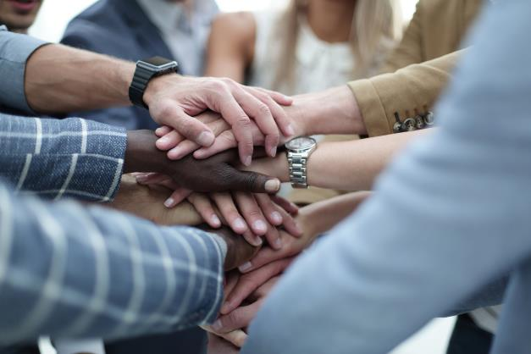
The Ethics of AI
Fairness
Reliability & Safety
Privacy & Security
Inclusiveness
Transparency
Accountability

Slide 10
Fairness
Reliability & Safety
Privacy & Security
Inclusiveness
The ethics of AI
Transparency
Accountability

Slide 11
Fairness
noun
the state, condition, or quality of being fair, or free from bias or injustice; evenhandedness:
I have to admit, in all fairness, that she would only be paid for part of the work.
Notes:
** FAIRNESS **
https://www.bloomberg.com/graphics/2016-amazon-same-day/
Prime Same-Day service includes 27 metropolitan areas. In most of them, it provides broad coverage within the city limits. In six major same-day delivery cities, however, the service area excludes predominantly black ZIP codes to varying degrees, according to a Bloomberg analysis that compared Amazon same-day delivery areas with U.S. Census Bureau data.
In Atlanta, Chicago, Dallas, and Washington, cities still struggling to overcome generations of racial segregation and economic inequality, black citizens are about half as likely to live in neighborhoods with access to Amazon same-day delivery as white residents. The disparity in two other big cities is significant, too. In New York City, same-day delivery is available throughout Manhattan, Staten Island, and Brooklyn, but not in the Bronx and some majority-black neighborhoods in Queens. In some cities, Amazon same-day delivery extends many miles into the surrounding suburbs but isn’t available in some ZIP codes within the city limits.
The most striking gap in Amazon’s same-day service is in Boston, where three ZIP codes encompassing the primarily black neighborhood of Roxbury are excluded from same-day service, while the neighborhoods that surround it on all sides are eligible
There’s no evidence that Amazon makes decisions on where to deliver based on race. Craig Berman, Amazon’s vice president for global communications says the ethnic composition of neighborhoods isn’t part of the data Amazon examines when drawing up its maps. “When it comes to same-day delivery, our goal is to serve as many people as we can, which we’ve proven in places like Los Angeles, Seattle, San Francisco, and Philadelphia.” Amazon, he says, has a “radical sensitivity” to any suggestion that neighborhoods are being singled out by race. “Demographics play no role in it. Zero.”
Amazon says its plan is to focus its same-day service on ZIP codes where there’s a high concentration of Prime members, and then expand the offering to fill in the gaps over time.
This is a logical approach from a cost and efficiency perspective: Give areas with the most existing paying members priority access to a new product. Yet in cities where most of those paying members are concentrated in predominantly white parts of town, a solely data-driven calculation that looks at numbers instead of people can reinforce long-entrenched inequality in access to retail services. For people who live in black neighborhoods not served by Amazon, the fact that it’s not deliberate doesn’t make much practical difference. “They are offering different services to other people who don’t look like you but live in the same city,”
Fairness example, too

Slide 12
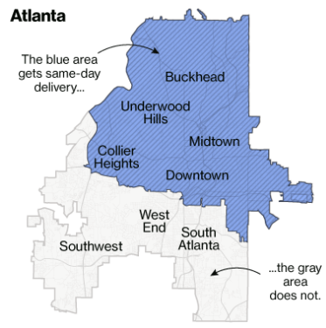
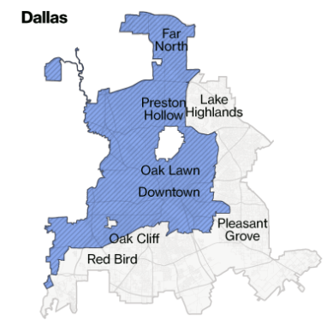

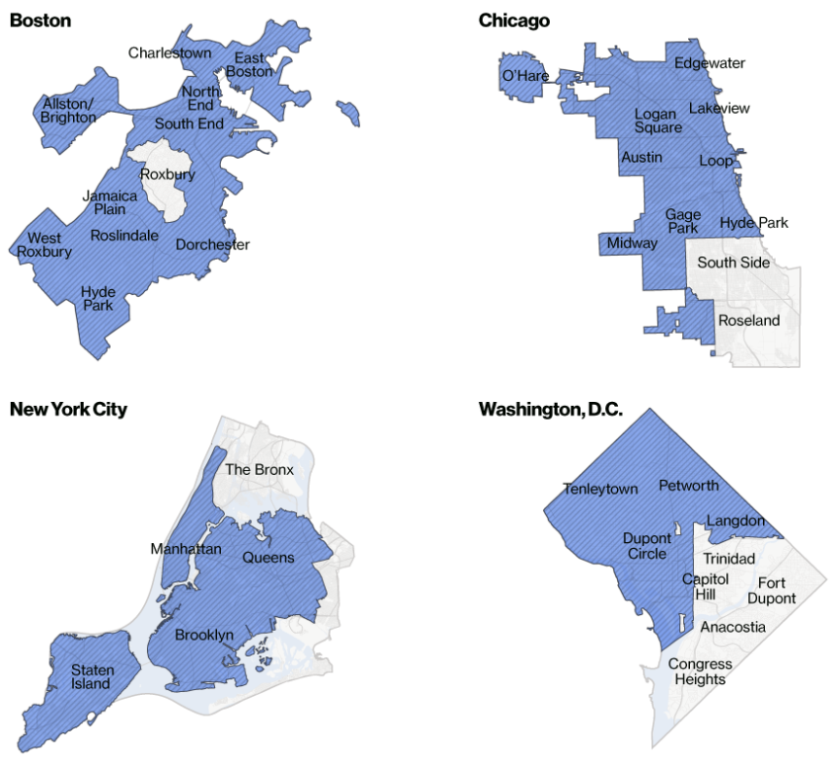
Fairness
Atlanta
Dallas
Same-Day
Not available
Boston
Chicago
New York City
Washington, D.C.
https://www.bloomberg.com/graphics/2016-amazon-same-day/
Notes:
** FAIRNESS **
https://www.bloomberg.com/graphics/2016-amazon-same-day/
Prime Same-Day service includes 27 metropolitan areas. In most of them, it provides broad coverage within the city limits. In six major same-day delivery cities, however, the service area excludes predominantly black ZIP codes to varying degrees, according to a Bloomberg analysis that compared Amazon same-day delivery areas with U.S. Census Bureau data.
In Atlanta, Chicago, Dallas, and Washington, cities still struggling to overcome generations of racial segregation and economic inequality, black citizens are about half as likely to live in neighborhoods with access to Amazon same-day delivery as white residents. The disparity in two other big cities is significant, too. In New York City, same-day delivery is available throughout Manhattan, Staten Island, and Brooklyn, but not in the Bronx and some majority-black neighborhoods in Queens. In some cities, Amazon same-day delivery extends many miles into the surrounding suburbs but isn’t available in some ZIP codes within the city limits.
The most striking gap in Amazon’s same-day service is in Boston, where three ZIP codes encompassing the primarily black neighborhood of Roxbury are excluded from same-day service, while the neighborhoods that surround it on all sides are eligible
There’s no evidence that Amazon makes decisions on where to deliver based on race. Craig Berman, Amazon’s vice president for global communications says the ethnic composition of neighborhoods isn’t part of the data Amazon examines when drawing up its maps. “When it comes to same-day delivery, our goal is to serve as many people as we can, which we’ve proven in places like Los Angeles, Seattle, San Francisco, and Philadelphia.” Amazon, he says, has a “radical sensitivity” to any suggestion that neighborhoods are being singled out by race. “Demographics play no role in it. Zero.”
Amazon says its plan is to focus its same-day service on ZIP codes where there’s a high concentration of Prime members, and then expand the offering to fill in the gaps over time.
This is a logical approach from a cost and efficiency perspective: Give areas with the most existing paying members priority access to a new product. Yet in cities where most of those paying members are concentrated in predominantly white parts of town, a solely data-driven calculation that looks at numbers instead of people can reinforce long-entrenched inequality in access to retail services. For people who live in black neighborhoods not served by Amazon, the fact that it’s not deliberate doesn’t make much practical difference. “They are offering different services to other people who don’t look like you but live in the same city,”
Fairness example, too

Slide 13
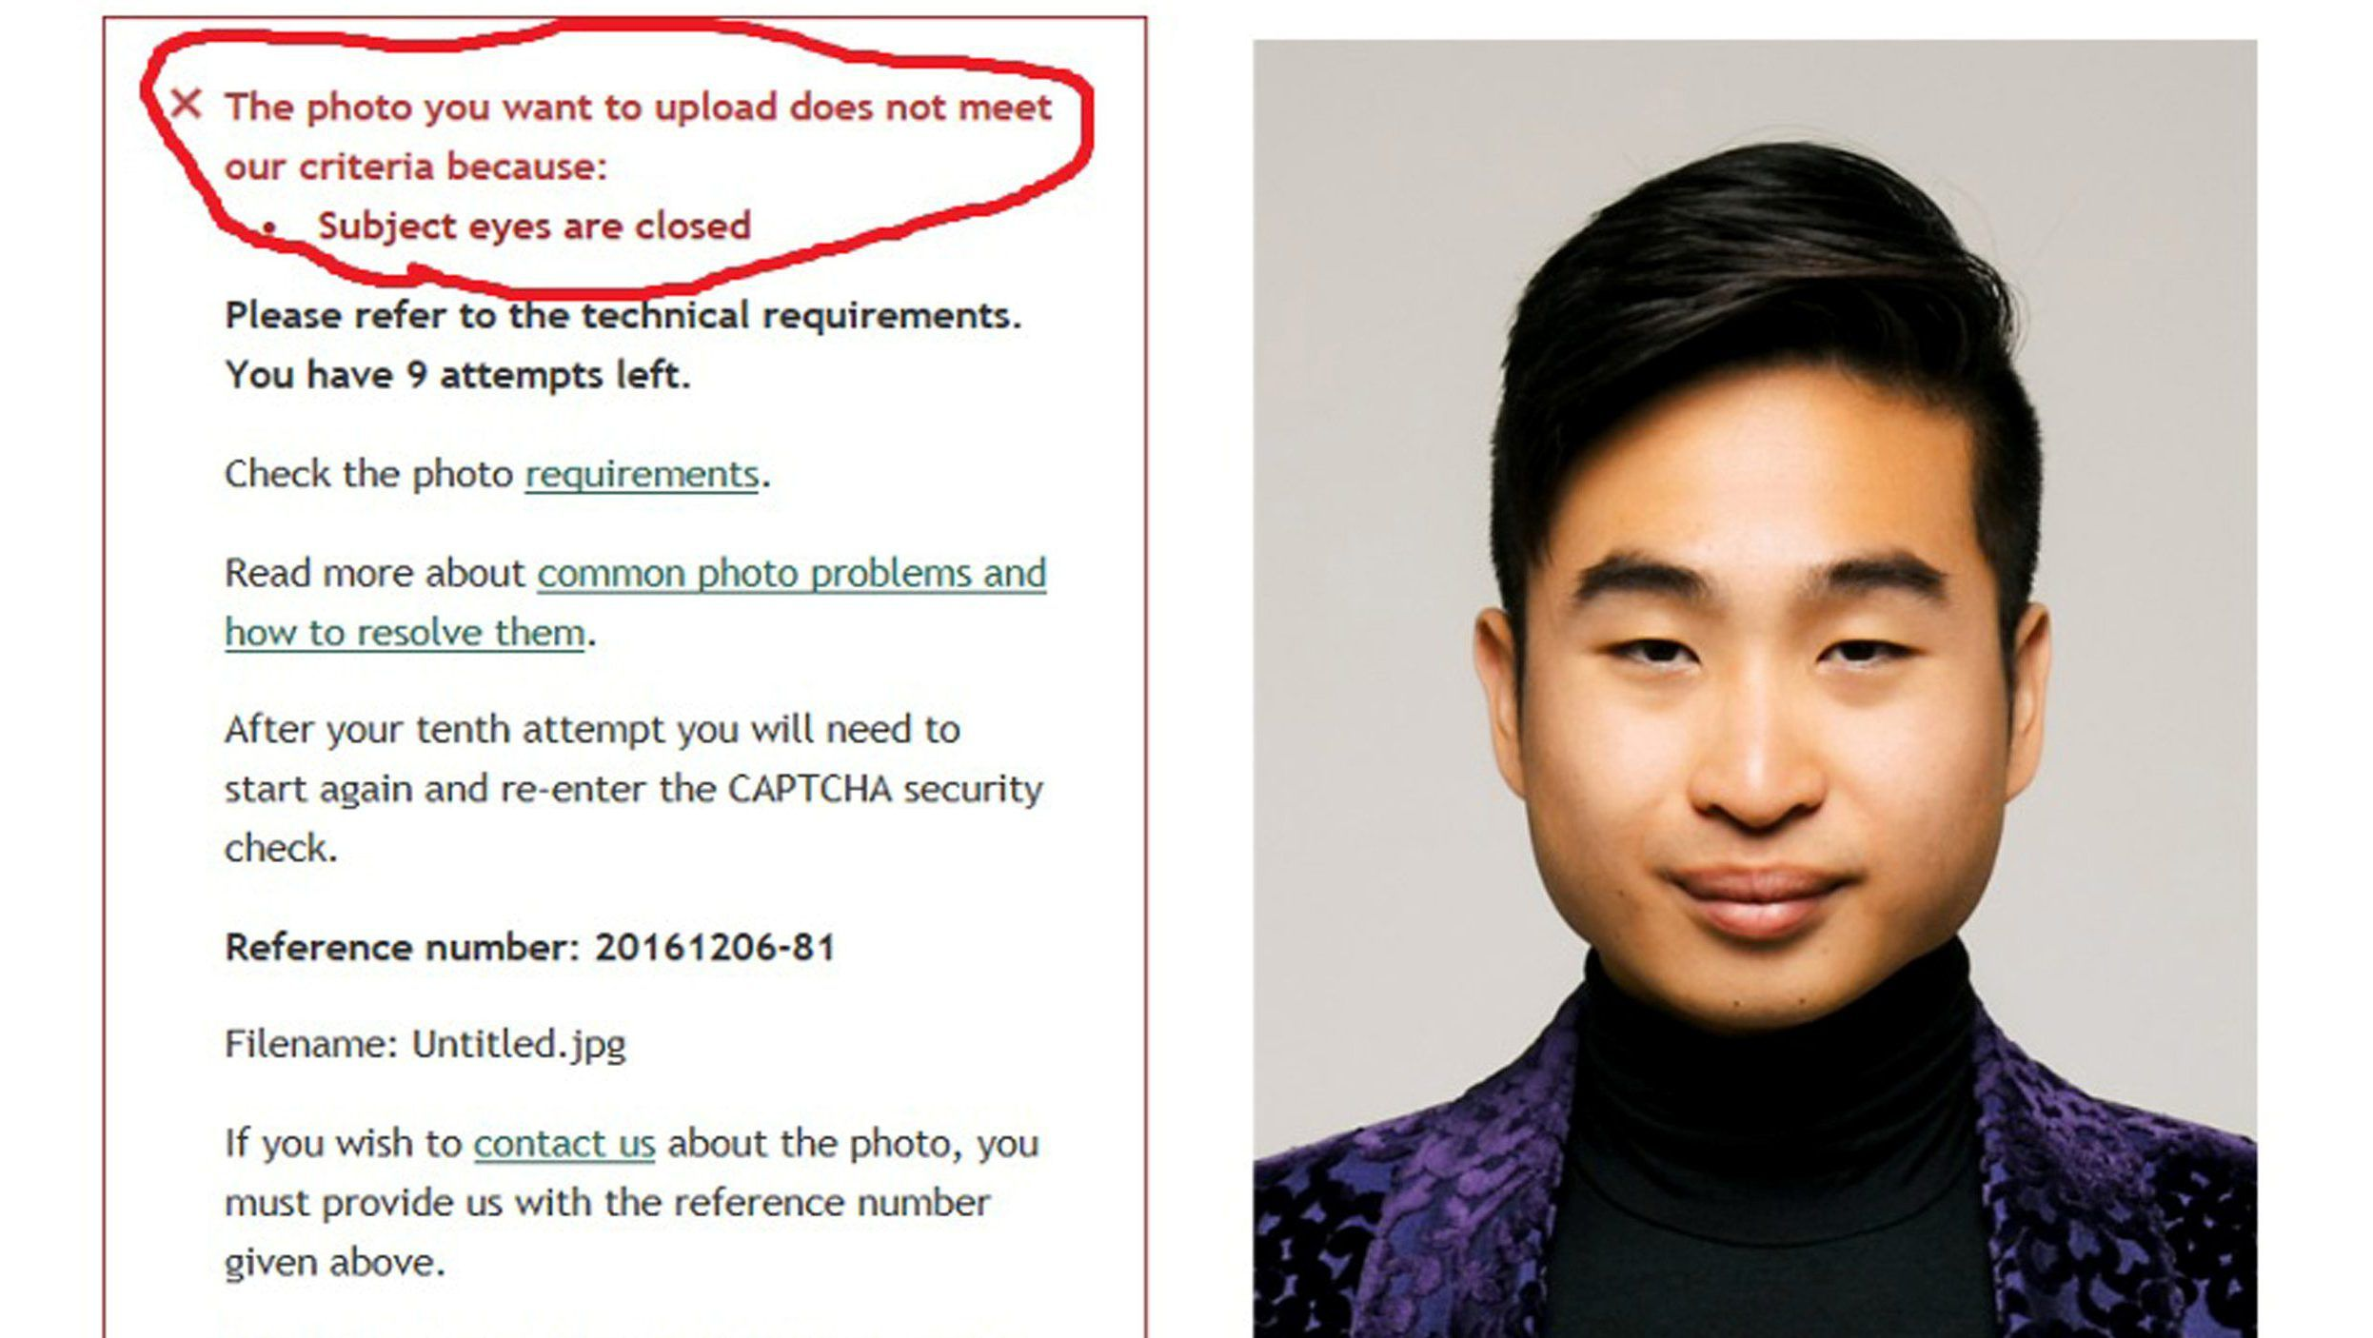
Fairness
Notes:
We see examples of bias across different applications of AI.
In this picture, this Asian man puts his picture and the passport software repeatedly declines his application saying that his eyes are closed.

Slide 14

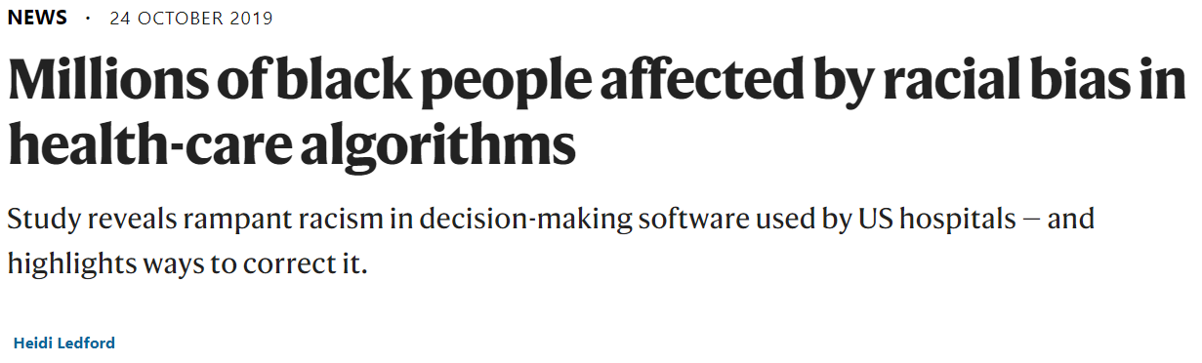
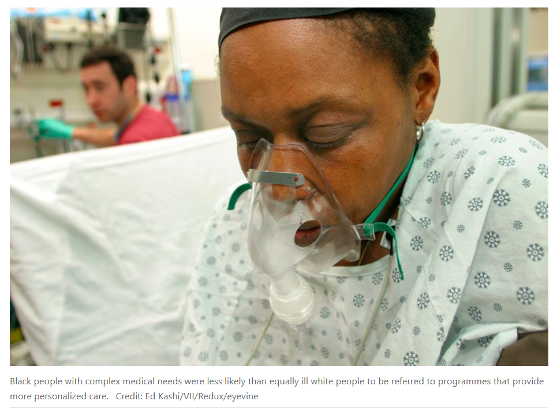
Fairness
Notes:
** FAIRNESS **
https://www.nature.com/articles/d41586-019-03228-6
An algorithm widely used in US hospitals to allocate health care to patients has been systematically discriminating against black people, a sweeping analysis has found.
The study, published in Science on 24 October¹, concluded that the algorithm was less likely to refer black people than white people who were equally sick to programmes that aim to improve care for patients with complex medical needs. Hospitals and insurers use the algorithm and others like it to help manage care for about 200 million people in the United States each year.
…

Slide 15
Fairness
Notes:
We see examples of bias in search well.
When I search for CEO in Bing, I see that all pictures are pictures of mostly white men, creating the impression that there are no women ceos.
The last examples of bias in our technologies are not isolated from the society we live in.
We have to acknowledge that the society we live in has different forms of biases that are not consistent with Microsoft values.
These biases are already prevalent in our data sets.
With the widespread use of AI and statistical learning,
We are at serious risk of spreading but also amplifying these biases in ways that we don’t understand.

Slide 16

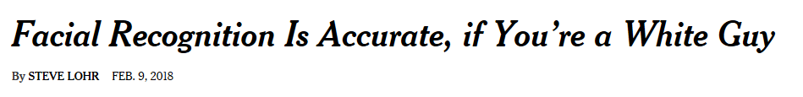
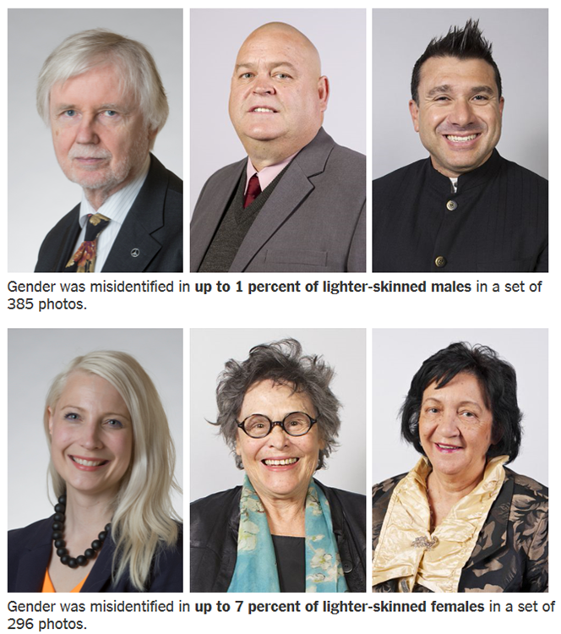
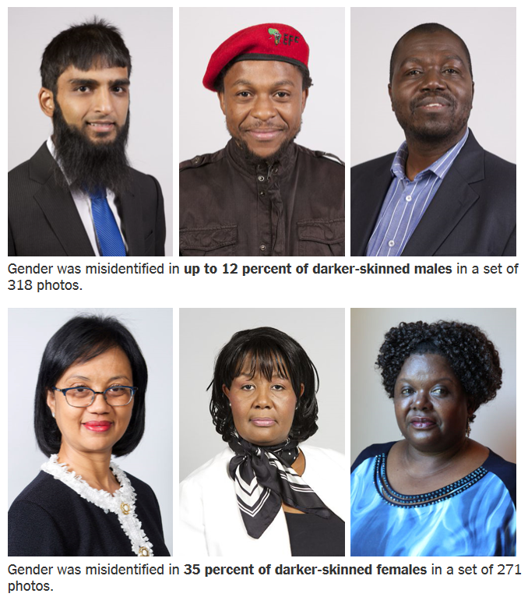
Fairness
Notes:
Understand how bias can be introduced and affect recommendations
Attract diverse pool of AI talent
Develop analytical techniques to detect and eliminate bias
Human review and domain expertise

Slide 17
Reliability & Safety
Fairness
Privacy & Security
Inclusiveness
The ethics of AI
Transparency
Accountability

Slide 18
Reliability & Safety
noun
the ability to be relied on or depended on, as for accuracy, honesty, or achievement.
noun
the state of being safe; freedom from the occurrence or risk of injury, danger, or loss.
the quality of averting or not causing injury, danger, or loss.
Notes:
** SAFETY & RELIABILITY **
Source: https://www.theverge.com/2018/6/6/17433482/ai-automated-surveillance-drones-spot-violent-behavior-crowds
Automated surveillance is going to become increasingly common as companies and researchers find new ways to use machine learning to analyze live video footage. A new project from scientists in the UK and India shows one possible use for this technology: identifying violent behavior in crowds with the help of camera-equipped drones.
In a paper titled “Eye in the Sky,” the researchers describe their system. It uses a simple Parrot AR quadcopter (which costs around $200) to transmit video footage over a mobile internet connection for real-time analysis. An algorithm trained using deep learning estimates the poses of humans in the video and matches them to postures the researchers have designated as “violent.” For the purposes of the project, just five poses are included: strangling, punching, kicking, shooting, and stabbing.
The scientists hope that systems like theirs will be used to detect crime in public spaces and at large events. Lead researcher Amarjot Singh of the University of Cambridge told The Verge that he was motivated by events like the Manchester Arena bombing in 2017. Singh said attacks like this could be prevented in future if surveillance cameras can automatically spot suspicious behavior, like someone leaving a bag unattended for a long period of time.
However, the research needs to be taken with a pinch of salt, particularly with regard to its claims of accuracy. Singh and his colleagues report that their system was 94 percent accurate at identifying “violent” poses, but they note that the more people that appear in frame, the lower this figure. (It fell to 79 percent accuracy when looking at 10 individuals.)
More importantly, though, these figures don’t represent real-world usage. In order to train and test their AI, the researchers recorded their own video clips of volunteers pretending to attack one another. The volunteers are generously spaced apart and attack one another with exaggerated movements. Singh acknowledged that this isn’t a perfect reflection of how the surveillance system might perform in the wild, but he said he has plans to test the drones during two upcoming festivals in India: Technozion and Spring Spree, both of which take place at NIT Warangal. “We have permission to fly over [Technozion], happening in a month and are seeking permission for the other,” said Singh.
Researchers working in this field often note there is a huge difference between staged tests and real-world use-cases. In the latter, the video footage is often blurry, the crowds are bigger, and people’s actions are more subtle and more prone to be misinterpreted. This last point is particularly telling, as Singh and his colleagues don’t produce any figures for the systems false positive rate — e.g., the frequency with which it identifies nonviolent behavior as violent. Think about how giving someone a high-five might be misinterpreted as a violent gesture, for example. (Singh denied that the system would make this sort of mistake, but said he and his team had not yet produced stats to support this claim.)
But even if this particular system has not yet proved itself in the wild, it’s a clear illustration of the direction contemporary research is going. Using AI to identify body poses is a common problem, with big tech companies like Facebook publishing significant research on the topic. And with the rise of cheap drones and fast mobile internet, it’s easier than ever to capture and transmit live video footage. Putting these pieces together to create sophisticated surveillance isn’t hard.
A figure from the paper showing how the software analyzes individuals poses and matches them to “violent” postures. The question is: how will this technology be used, and who will use it? Speaking to The Verge earlier this year about automated surveillance, a number of experts said these systems were ripe for abuse by law enforcement and authoritarian governments.
Jay Stanley, a senior policy analyst at the ACLU, said this technology would have a chilling effect on civil society, as people rightly fear they’re being constantly monitored and analyzed. “We want people to not just be free, but to feel free. And that means that they don’t have to worry about how an unknown, unseen audience may be interpreting or misinterpreting their every movement and utterance,” said Stanley.
Meredith Whittaker, a researcher who examines the social implications of AI, tweeted that Singh and his colleagues’ paper showed there was a “mounting ethical crisis” in the field, with scientists failing to examine potential misuses of the technology they’re helping build. Whittaker told The Verge that the paper’s methodology was questionable and that the lack of time given over to the work’s ethical implications was damning.
Speaking to The Verge, Singh defended his work. He said despite these criticisms, it could have a positive effect on the word: stopping crime and terrorism. He suggested that new regulations might be needed so such technology isn’t misused, but he admitted there was “no good answer” to the worrying scenarios experts like Whittaker and Stanley are predicting. “Anything can be used for good. Anything can be used for bad,” said Singh.
Update June 6th, 12:20PM ET: The story has been updated to include additional comment from the researchers and to specify which festivals the drones will be tested at.

Slide 19
Reliability & Safety
Miles & years needed for to demonstrate autonomous vehicle reliability
Benchmark Failure Rate
Statistical Question | How many miles (years*) would autonomous vehicles have to be driven… | (A) 1.09 fatalities per 100 million miles? | (B) 77 reported injuries per 100 million miles? | (C) 190 reported crashes per 100 million miles?
 | (1) Without failure to demonstrate with 95% confidence their failure | 275 million miles (12.5 years) | 3.9 million miles (2 months) | 1.6 million miles (I month)
 | (2) To demonstrate 95% confidence their failure to within 20% of the true rate of… | 8.8 billion miles (400 years) | 125 million miles (5.7 years) | 51 million miles (2.3 years)
 | (3) To demonstrate with 95% confidence and 80% power that their failure rate is 20% better than the human driver failure rate of… | 11 billion miles (500 years) | 161 million miles (7.3 years) | 65 million miles (3 years)
*We assess the time it would take to compete the requisite miles with a fleet of 100 autonomous vehicles (larger than any known existing fleet) driving 24 hours a day, 365 days a year, at an average speed of 25 miles per hour.
Source: Rand Corp. Driving to Safety; Kara & Paddock
Notes:
Is there gender bias in lending?

Slide 20
Privacy & Security
Fairness
Reliability & Safety
Inclusiveness
The ethics of AI
Transparency
Accountability

Slide 21
Privacy & Security
Noun
the state of being apart from other people or concealed from their view; solitude; seclusion: Please leave the room and give me some privacy.
the state of being free from unwanted or undue intrusion or disturbance in one's private life or affairs; freedom to be let alone: Tourists must respect the tribe’s privacy. Those who wish to smoke can do so in the privacy of their own homes.
Noun
freedom from danger, risk, etc.; safety.
freedom from care, anxiety, or doubt; well-founded confidence.
something that secures or makes safe; protection; defense.
Notes:
Strava’s heat map revealed military bases around the world and exposed soldiers to real danger – not AI per se, but useful for a data discussion
https://www.nytimes.com/2018/01/29/world/middleeast/strava-heat-map.html
Same thing happened in Russia, too: https://www.foxnews.com/tech/secret-military-bases-inadvertently-exposed-by-russian-satellite-map-company

Slide 22
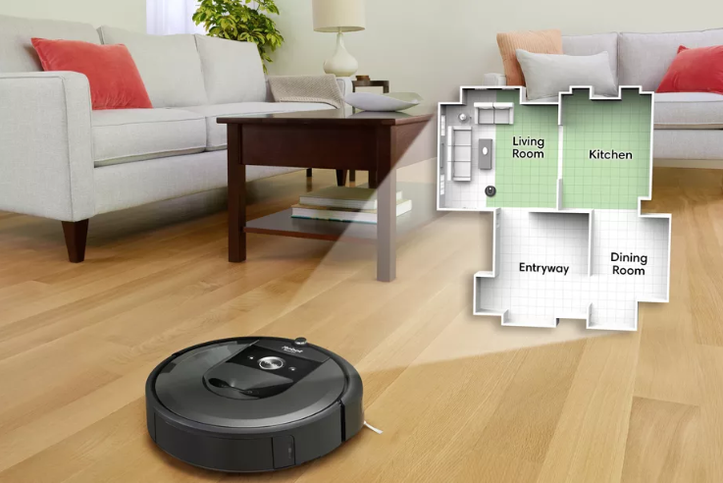
Privacy & Security
Notes:
iRobot’s latest Roomba, the i7+, creates maps using a combination of odometry data (measuring how far the robovac’s wheels move) and low-res camera imagery. The resulting maps can be used to create custom cleaning schedules or to let users ask their Roomba to vacuum specific rooms. An integration with Google Assistant lets customers give verbal commands like, “OK Google, tell Roomba to clean the kitchen.” - this is voluntary action and needs user’s consent
Just this month, for example, the company admitted it had exposed the personal data of around 500,000 Google+ users, leading to the closure of the platform.
It also announced it was reviewing access to Gmail by third-party companies after it was revealed that many developers were reading and analyzing users’ personal mail for marketing and data mining.
https://www.engadget.com/2018/10/31/google-and-irobot-smart-home-partnership/
https://www.theverge.com/2018/10/31/18041876/google-irobot-smart-home-spatial-data-mapping-collaboration

Slide 23
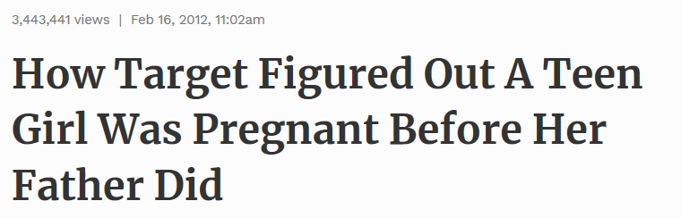

Privacy & Security
“
“
We knew that if we could identify them in their second trimester, there’s a good chance we could capture them for years
Andrew Pole, Statistician, Target
Notes:
** PRIVACY & SECURITY ** (many non-US, non-retail customers are still unfamiliar with this 2012 example)
https://www.nytimes.com/2012/02/19/magazine/shopping-habits.html
Andrew Pole had just started working as a statistician for Target in 2002, when two colleagues from the marketing department stopped by his desk to ask an odd question: “If we wanted to figure out if a customer is pregnant, even if she didn’t want us to know, can you do that? ”
Pole has a master’s degree in statistics and another in economics, and has been obsessed with the intersection of data and human behavior most of his life. His parents were teachers in North Dakota, and while other kids were going to 4-H, Pole was doing algebra and writing computer programs. “The stereotype of a math nerd is true,” he told me when I spoke with him last year. “I kind of like going out and evangelizing analytics.”
New moms are a lucrative customer segment for retailers like Target
Because birth records are usually public, the moment a couple have a new baby, they are almost instantaneously barraged with offers and incentives and advertisements from all sorts of companies.
The key is to reach them earlier, before any other retailers know a baby is on the way. Specifically, the marketers said they wanted to send specially designed ads to women in their second trimester, which is when most expectant mothers begin buying all sorts of new things, like prenatal vitamins and maternity clothing. “Can you give us a list?” the marketers asked.
“We knew that if we could identify them in their second trimester, there’s a good chance we could capture them for years,”
As Pole’s computers crawled through the data, he was able to identify about 25 products that, when analyzed together, allowed him to assign each shopper a “pregnancy prediction” score. More important, he could also estimate her due date to within a small window, so Target could send coupons timed to very specific stages of her pregnancy.
About a year after Pole created his pregnancy-prediction model, a man walked into a Target outside Minneapolis and demanded to see the manager. He was clutching coupons that had been sent to his daughter, and he was angry, according to an employee who participated in the conversation. “My daughter got this in the mail!” he said. “She’s still in high school, and you’re sending her coupons for baby clothes and cribs? Are you trying to encourage her to get pregnant?”

Slide 24

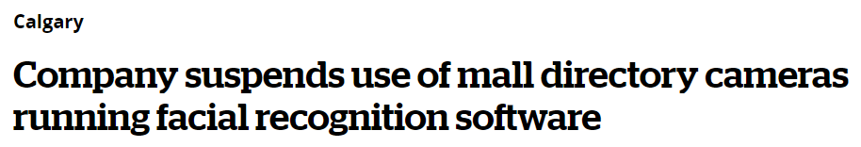
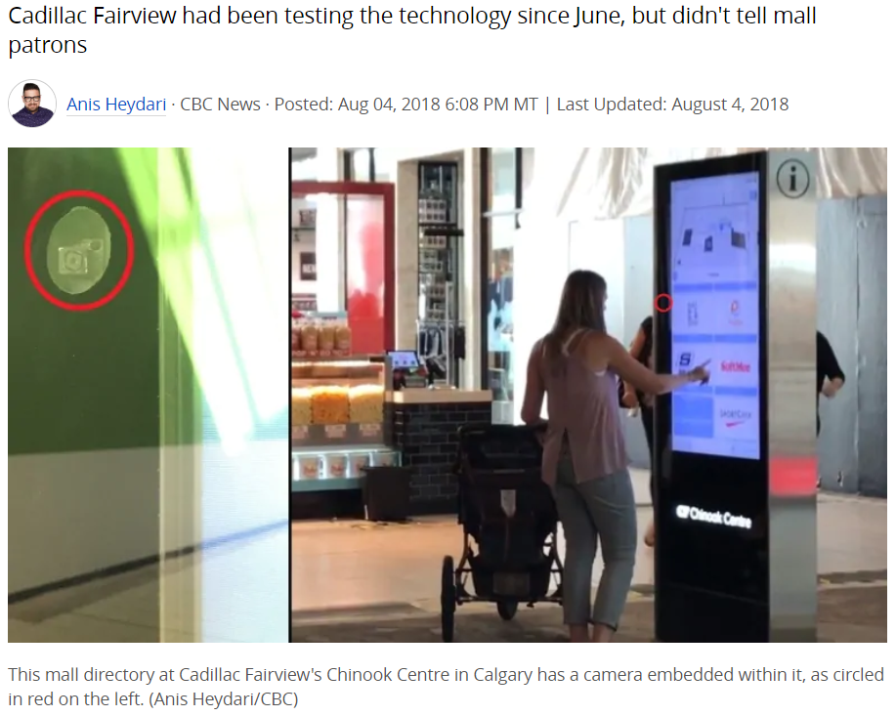
Privacy & Security
Notes:
Similar situation in Canada: https://www.cbc.ca/news/canada/calgary/cadillac-fairview-mall-directory-facial-recognition-suspended-1.4774692
using facial recognition software in their mall directories since June to track shoppers' ages and genders without telling them

Slide 25
Inclusiveness
Fairness
Reliability & Safety
Privacy & Security
The ethics of AI
Transparency
Accountability

Slide 26
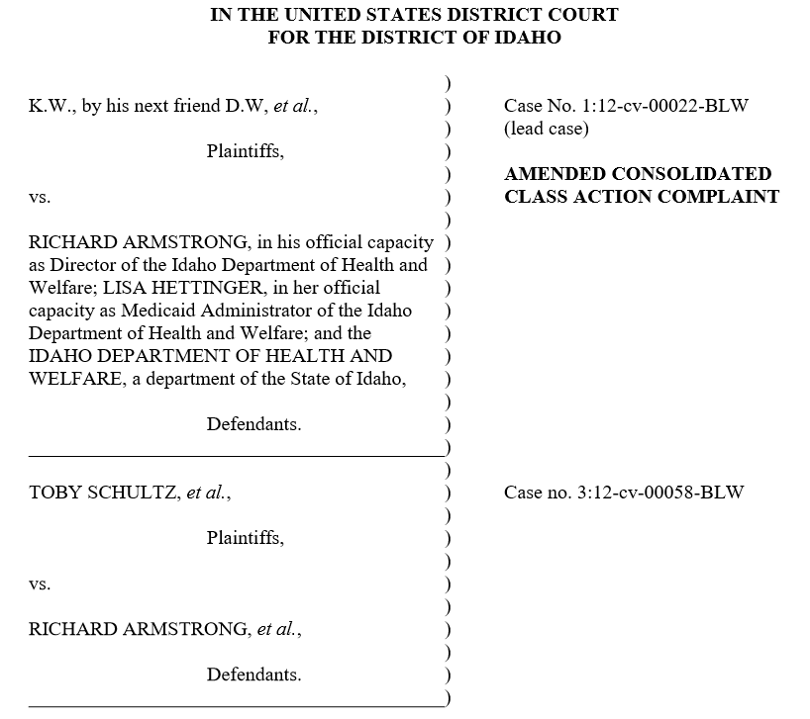
Inclusiveness
adjective
including or encompassing the stated limit or extremes in consideration or account (usually used postpositively): from 6 to 37 inclusive.
including a great deal, or encompassing everything concerned; comprehensive: an inclusive art form; an inclusive fee.
Notes:
** Inclusiveness or Transparency **
https://www.acluidaho.org/sites/default/files/field_documents/class_action_complaint.pdf
The ACLU of Idaho represents adults with developmental disabilities throughout the state in a case called K.W. v. Armstrong. With functional ages of 8-years-old and below, these Idahoans rely on Medicaid assistance to live in their communities and with their families, rather than in costly institutional settings.
When the State of Idaho drastically cut their assistance to dangerously low levels, the Idaho Department of Health and Welfare claimed that the reasons for the cuts were “trade secrets” and refused to disclose the algorithm it used to calculate the reductions.
ACLU obtained an injunction stopping the cuts and requiring the State to make its Medicaid formulas public for all Idaho residents to review, which the Ninth Circuit Court of Appeals upheld in 2015. In March 2016, Idaho’s federal district court struck down the Department’s formula and ordered to State to develop comprehensive plans to bring its system up to constitutional muster. A class action settlement was submitted to the Court in September 2016, and is now awaiting Court approval. If approved, the settlement will require the Department of Health and Welfare to develop a new system, with input and oversight by the ACLU of Idaho and participants and their families throughout the state.
https://www.acluidaho.org/en/cases/kw-v-Armstrong
Once a system is found to be discriminatory or otherwise inaccurate, there is an additional challenge in redesigning the system. Ideally, government agencies should develop an inclusive redesign process that allows communities affected by algorithmic decision systems to meaningfully participate. But this approach is frequently met with resistance. Currently, the plaintiffs in​ this case​ ​are working with the Idaho Department of Health and Welfare to develop a new model.
https://ainowinstitute.org/litigatingalgorithms.pdf

Slide 27
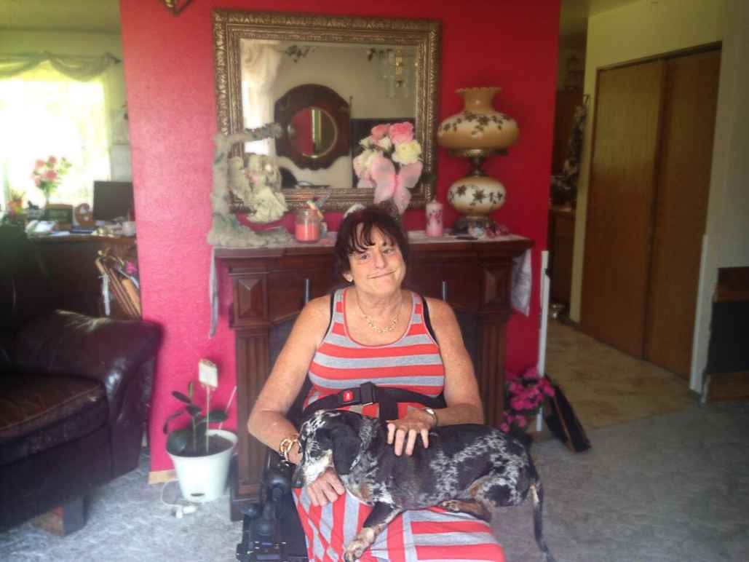
Inclusiveness
K. W. v. Armstrong plaintiff Christie Mathwig
https://www.acluidaho.org/sites/default/files/field_documents/class_action_complaint.pdf
Notes:
** Inclusiveness or Transparency **
https://www.acluidaho.org/sites/default/files/field_documents/class_action_complaint.pdf
The ACLU of Idaho represents adults with developmental disabilities throughout the state in a case called K.W. v. Armstrong. With functional ages of 8-years-old and below, these Idahoans rely on Medicaid assistance to live in their communities and with their families, rather than in costly institutional settings.
When the State of Idaho drastically cut their assistance to dangerously low levels, the Idaho Department of Health and Welfare claimed that the reasons for the cuts were “trade secrets” and refused to disclose the algorithm it used to calculate the reductions.
ACLU obtained an injunction stopping the cuts and requiring the State to make its Medicaid formulas public for all Idaho residents to review, which the Ninth Circuit Court of Appeals upheld in 2015. In March 2016, Idaho’s federal district court struck down the Department’s formula and ordered to State to develop comprehensive plans to bring its system up to constitutional muster. A class action settlement was submitted to the Court in September 2016, and is now awaiting Court approval. If approved, the settlement will require the Department of Health and Welfare to develop a new system, with input and oversight by the ACLU of Idaho and participants and their families throughout the state.
https://www.acluidaho.org/en/cases/kw-v-Armstrong
Once a system is found to be discriminatory or otherwise inaccurate, there is an additional challenge in redesigning the system. Ideally, government agencies should develop an inclusive redesign process that allows communities affected by algorithmic decision systems to meaningfully participate. But this approach is frequently met with resistance. Currently, the plaintiffs in​ this case​ ​are working with the Idaho Department of Health and Welfare to develop a new model.
https://ainowinstitute.org/litigatingalgorithms.pdf

Slide 28
Transparency
Fairness
Reliability & Safety
Privacy & Security
Inclusiveness
The ethics of AI
Accountability

Slide 29
Transparency
adjective
having the property of transmitting rays of light through its substance so that bodies situated beyond or behind can be distinctly seen.
admitting the passage of light through interstices.
so sheer as to permit light to pass through; diaphanous.
easily seen through, recognized, or detected: transparent excuses.
Notes:
** SAFETY & RELIABILITY or TRANSPARENCY **
Predicting pneumonia risk (1995) – Rich Caruana case study
10 million patients, 1000’s of features, train a model on the data, AUC = .95
Is it safe to deploy and use on real patients?
Is accurate prediction on test data enough?
Trained an accurate black box, but didn’t know what was inside – human factors not discernable in data
Looked at a bunch of different ML models
Multitask neural net was the most accurate – was it safe?
No – use logistic regression instead – the poorest-performing model, but most intelligble
Goal was to predict your pneumonia risk level to decide whether or not to admit to hospital
Low: antibiotics, chicken soup, call us if you’re not feeling better
High: admit to hospital … 10% of pneumonia patients in the study die)
RBL learned rule: HasAsthma(x) => LessRisk (x)
Counterintuitive, as pneumonia is very dangerous to asthmatics
People with asthma who present with pneumonia go to the ER right away, get highest standard of medical care immediately, often admitted to hospital, and realize better outcomes
Lesser probability of death than gen pop
Appears in data to suggest having asthma is a good thing if you get pneumonia – the opposite of reality
True pattern in the data – strictly speaking, it’s accurate
Good news: treatment is so effective it lowers risk of dying compared to gen pop
Bad news: if we use this model to make decisions about whether or not to admit to hospital, it would hurt asthmatics – not at all safe to use
This could be a transparency example, too:
Key problem: bad patterns we don’t know about
Neural net is more accurate and can learn things that the RBL didn’t
But you don’t know everything the neural net used
Really need to understand the model before you deploy it
Now, through a technique called Generalized Additive Models, whereby the influence of individual attributes in the training data can be independently measured, we’ve not only trained a new model where the outputs are completely transparent, but we’ve actually improved performance over the old model.
Asthmatics were being sent home sooner because they were rushed to the front of the line as soon as they arrived at the hospital.
Faster and more targeted care led to better results.
And all the model learned from were the results.

Slide 30
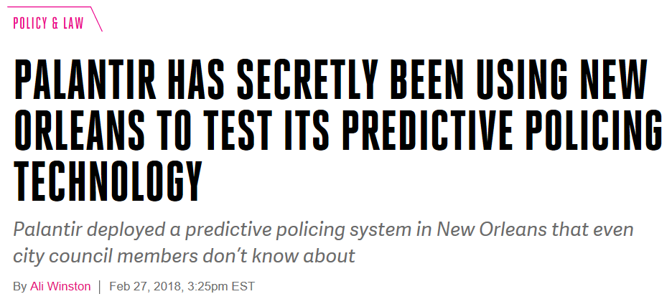
Transparency
Notes:
** ACCOUNTABILITY or TRANSPARENCY **
https://www.theverge.com/2018/2/27/17054740/palantir-predictive-policing-tool-new-orleans-nopd
One of the tools used by the New Orleans Police Department to identify members of gangs like 3NG and the 39ers came from the Silicon Valley company Palantir. The company provided software to a secretive NOPD program that traced people’s ties to other gang members, outlined criminal histories, analyzed social media, and predicted the likelihood that individuals would commit violence or become a victim.
As part of the discovery process in Lewis’ trial, the government turned over more than 60,000 pages of documents detailing evidence gathered against him from confidential informants, ballistics, and other sources — but they made no mention of the NOPD’s partnership with Palantir, according to a source familiar with the 39ers trial.
Related:
Ethics Principle: Accountability & Fairness
Source: http://www.sciencemag.org/news/2018/02/artificial-intelligence-could-identify-gang-crimes-and-ignite-ethical-firestorm
When someone roughs up a pedestrian, robs a store, or kills in cold blood, police want to know whether the perpetrator was a gang member: Do they need to send in a special enforcement team? Should they expect a crime in retaliation? Now, a new algorithm is trying to automate the process of identifying gang crimes. But some scientists warn that far from reducing gang violence, the program could do the opposite by eroding trust in communities, or it could brand innocent people as gang members.
That has created some tensions. At a presentation of the new program this month, one audience member grew so upset he stormed out of the talk, and some of the creators of the program have been tight-lipped about how it could be used.
“This is almost certainly a well-intended piece of work,” says Google software engineer Blake Lemoine, who is based in Mountain View, California, and has studied ways of reducing bias in artificial intelligence. “But have the researchers considered the possible unintended side effects?”
For years, scientists have been using computer algorithms to map criminal networks, or to guess where and when future crimes might take place, a practice known as predictive policing. But little work has been done on labeling past crimes as gang-related.
In the new work, researchers developed a system that can identify a crime as gang-related based on only four pieces of information: the primary weapon, the number of suspects, and the neighborhood and location (such as an alley or street corner) where the crime took place. Such analytics, which can help characterize crimes before they’re fully investigated, could change how police respond, says Doug Haubert, city prosecutor for Long Beach, California, who has authored strategies on gang prevention.
To classify crimes, the researchers invented something called a partially generative neural network. A neural network is made of layers of small computing elements that process data in a way reminiscent of the brain’s neurons. A form of machine learning, it improves based on feedback—whether its judgments were right. In this case, researchers trained their algorithm using data from the Los Angeles Police Department (LAPD) in California from 2014 to 2016 on more than 50,000 gang-related and non–gang-related homicides, aggravated assaults, and robberies.
The researchers then tested their algorithm on another set of LAPD data. The network was “partially generative,” because even when it did not receive an officer’s narrative summary of a crime, it could use the four factors noted above to fill in that missing information and then use all the pieces to infer whether a crime was gang-related. Compared with a stripped-down version of the network that didn’t use this novel approach, the partially generative algorithm reduced errors by close to 30%, the team reported at the Artificial Intelligence, Ethics, and Society (AIES) conference this month in New Orleans, Louisiana. The researchers have not yet tested their algorithm’s accuracy against trained officers.
It’s an “interesting paper,” says Pete Burnap, a computer scientist at Cardiff University who has studied crime data. But although the predictions could be useful, it’s possible they would be no better than officers’ intuitions, he says. Haubert agrees, but he says that having the assistance of data modeling could sometimes produce “better and faster results.” Such analytics, he says, “would be especially useful in large urban areas where a lot of data is available.”
But researchers attending the AIES talk raised concerns during the Q&A afterward. How could the team be sure the training data were not biased to begin with? What happens when someone is mislabeled as a gang member? Lemoine asked rhetorically whether the researchers were also developing algorithms that would help heavily patrolled communities predict police raids.
Hau Chan, a computer scientist now at Harvard University who was presenting the work, responded that he couldn’t be sure how the new tool would be used. “I’m just an engineer,” he said. Lemoine quoted a lyric from a song about the wartime rocket scientist Wernher von Braun, in a heavy German accent: “Once the rockets are up, who cares where they come down?” Then he angrily walked out.
Approached later for comment, Lemoine said he had talked to Chan to smooth things over. “I don’t necessarily think that we shouldn’t build tools for the police, or that we should,” Lemoine said (commenting, he specified, as an individual, not as a Google representative). “I think that when you are building powerful things, you have some responsibility to at least consider how could this be used.”
Two of the paper’s senior authors spent nearly 20 minutes deflecting such questions during a later interview. “It’s kind of hard to say at the moment,” said Jeffrey Brantingham, an anthropologist at the University of California, Los Angeles. “It’s basic research.” Milind Tambe, a computer scientist at the University of Southern California in Los Angeles, agreed. Might a tool designed to classify gang crime be used to, say, classify gang crime? They wouldn’t say.
The researchers are happy to talk about other applications for partially generative neural networks: classifying wildlife crime, improving grasslands management, and predicting which people would be best at spreading public health information to their peers. Basically, any time you have only partial information about a situation, which is pretty much all the time.

Slide 31
Accountability
Fairness
Reliability & Safety
Privacy & Security
Inclusiveness
The ethics of AI
Transparency

Slide 32
Accountability
“
Whom do I sue when I get hit by a driverless car? What if a medical robot gives a patient the wrong drug? What if my vacuum robot sucks up my hair while I am napping on the floor (as actually happened to a woman in South Korea recently)? And can a robot commit a war crime?
adjective
subject to the obligation to report, explain, or justify something; responsible; answerable.
capable of being explained; explicable; explainable.
“
Notes:
** ACCOUNTABILITY **
https://www.washingtonpost.com/local/trafficandcommuting/when-driverless-cars-crash-who-gets-the-blame-and-pays-the-damages/2017/02/25/3909d946-f97a-11e6-9845-576c69081518_story.html
https://www.theglobeandmail.com/news/world/if-a-robot-kills-someone-who-is-to-blame/article23996250/
##
Evaluate training data
Test extensively (and enable a user
feedback loop)
Monitor ongoing performance
Design for unexpected circumstances—including nefarious attacks
Human in the loop
Policy toolkit (AI Now Institute) - https://ainowinstitute.org/aap-toolkit.pdf
Banks: Equal Credit Oipp’y Act in the US – can’t discriminate

Slide 33
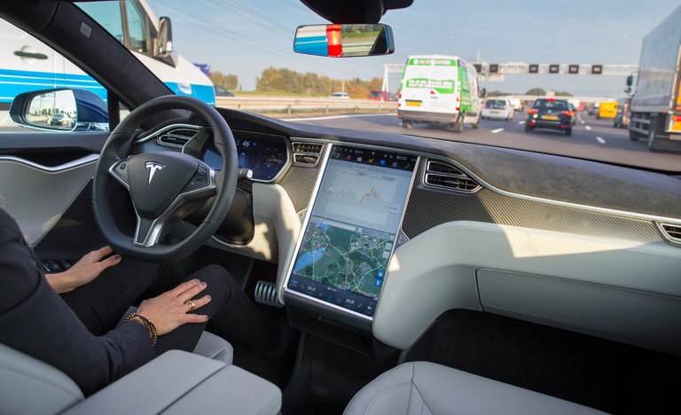
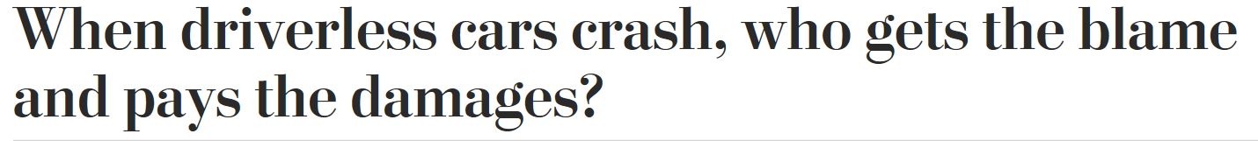
Accountability
“
Whom do I sue when I get hit by a driverless car? What if a medical robot gives a patient the wrong drug? What if my vacuum robot sucks up my hair while I am napping on the floor (as actually happened to a woman in South Korea recently)? And can a robot commit a war crime?
“
Notes:
** ACCOUNTABILITY **
https://www.washingtonpost.com/local/trafficandcommuting/when-driverless-cars-crash-who-gets-the-blame-and-pays-the-damages/2017/02/25/3909d946-f97a-11e6-9845-576c69081518_story.html
https://www.theglobeandmail.com/news/world/if-a-robot-kills-someone-who-is-to-blame/article23996250/
##
Evaluate training data
Test extensively (and enable a user
feedback loop)
Monitor ongoing performance
Design for unexpected circumstances—including nefarious attacks
Human in the loop
Policy toolkit (AI Now Institute) - https://ainowinstitute.org/aap-toolkit.pdf
Banks: Equal Credit Oipp’y Act in the US – can’t discriminate

Slide 34

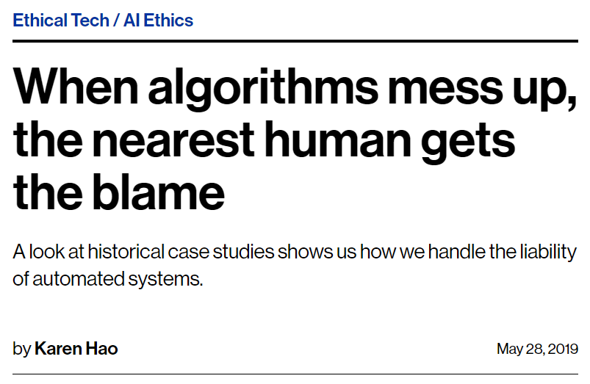
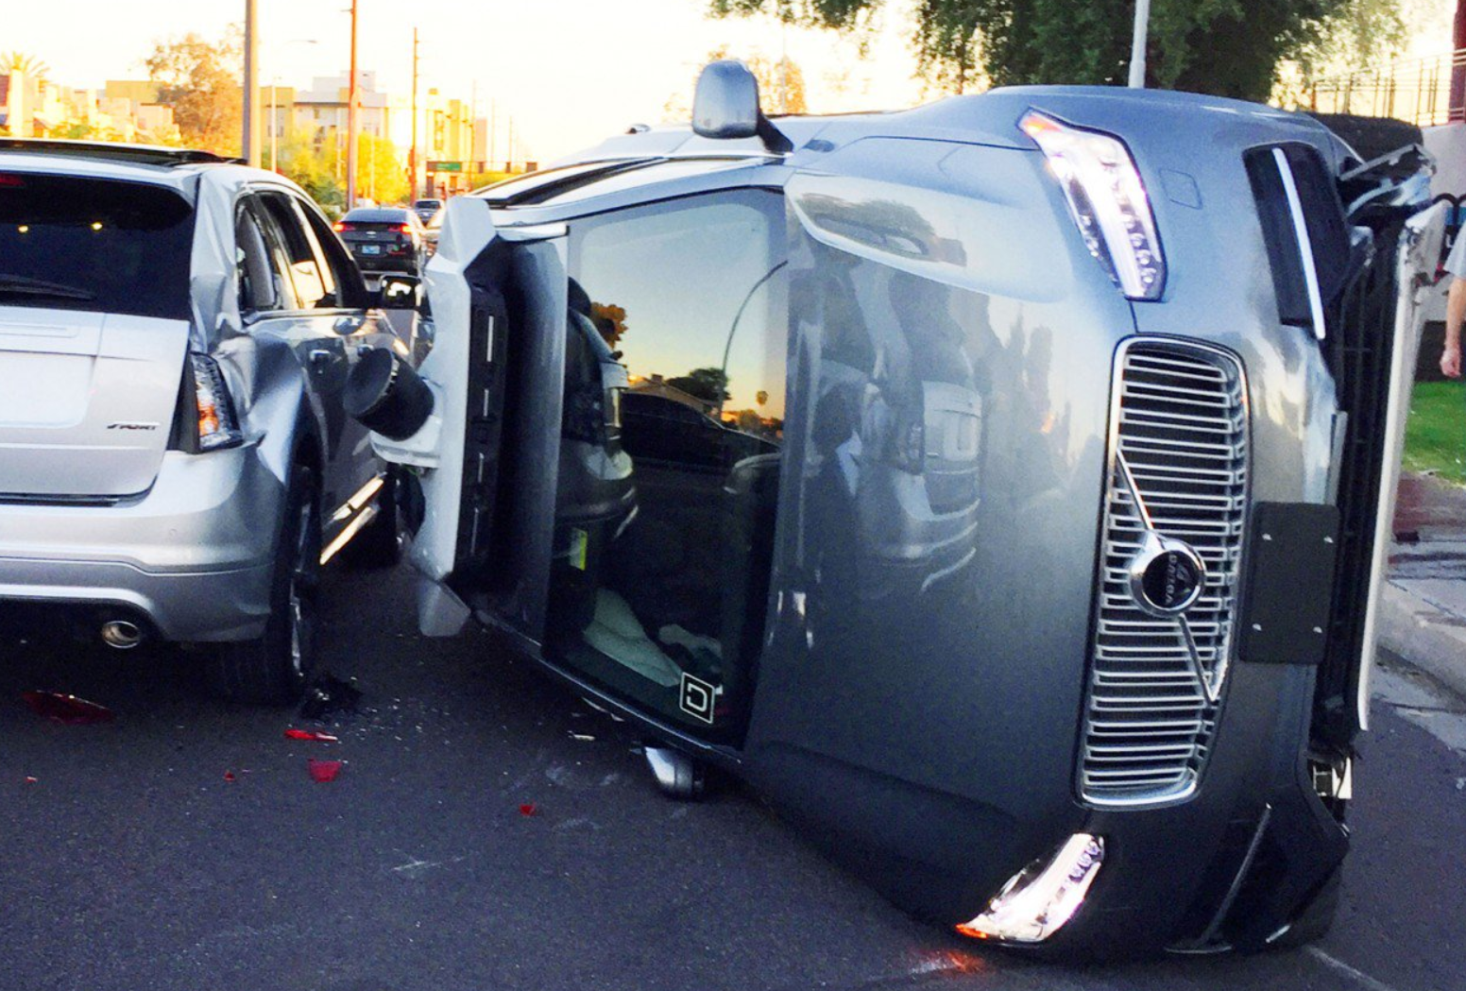
Accountability
Notes:
https://www.technologyreview.com/s/613578/ai-algorithms-liability-human-blame/
Reference lawsuit
https://www.bloomberg.com/news/articles/2019-05-06/who-to-sue-when-a-robot-loses-your-fortune?mod=djemAIPro
So a Hong Kong tycoon is doing the next best thing. He’s going after the salesman who persuaded him to entrust a chunk of his fortune to the supercomputer whose trades cost him more than $20 million.
The case pits Samathur Li Kin-kan, whose father is a major investor in Shaftesbury Plc, which owns much of London’s Chinatown, Covent Garden and Carnaby Street, against Raffaele Costa, who has spent much of his career selling investment funds for the likes of Man Group Plc and GLG Partners Inc. It’s the first-known instance of humans going to court over investment losses triggered by autonomous machines and throws the spotlight on the “black box” problem: If people don’t know how the computer is making decisions, who’s responsible when things go wrong?
Developed by Austria-based AI company 42.cx, the supercomputer named K1 would comb through online sources like real-time news and social media to gauge investor sentiment and make predictions on U.S. stock futures. It would then send instructions to a broker to execute trades, adjusting its strategy over time based on what it had learned.
Thomas Beardsworth, Bloomberg News
Lesson for creators of AI is to be very careful about what you’re claiming your technology can do, otherwise there could be a misrepresentation claim against you

Slide 35
The ethics of AI
Fairness
Reliability & Safety
Privacy & Security
Inclusiveness
Transparency
Accountability

Slide 36
RAI Technical Workshop
https://docs.microsoft.com/en-us/learn/modules/microsoft-responsible-ai-practices/6-responsible-ai-tools

Slide 37
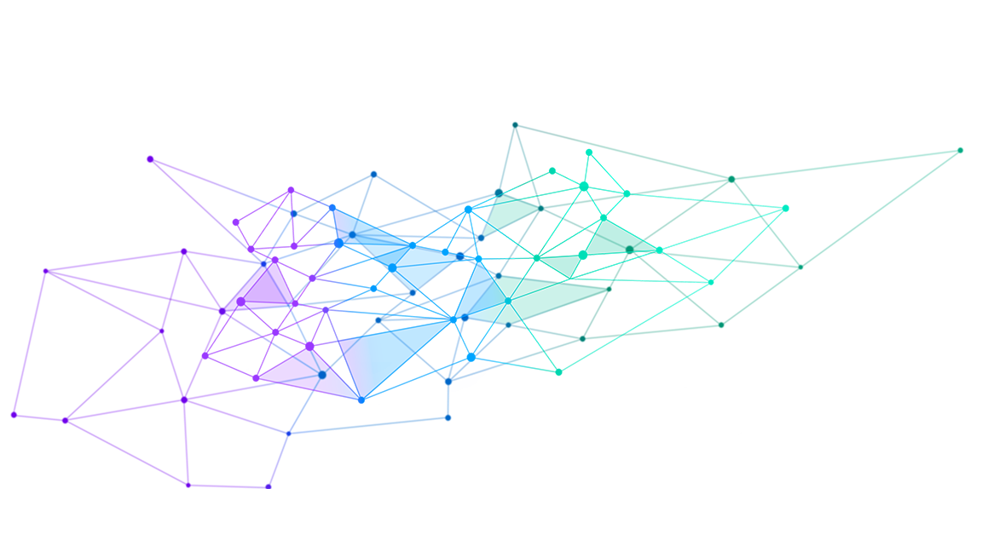

The Responsible AI Lifecycle
EVOLVE
PEOPLE & PRINCIPLES
ENVISION
Create according to Microsoft’s AI principles
By continually analyzing & improving
AI benefits & potential risks and consult diverse stakeholders
LAUNCH
FAIRNESS
RELIABILITY AND SAFETY
PRIVACY & SECURITY
DEFINE
After diverse ring-testing with escalation and recovery plan
INCLUSIVENESS
TRANSPARENCY
Objectives, data requirements & responsible metrics
BUILD
ACCOUNTABILITY
PROTOTYPE
And integrate AI according to responsible metrics & tradeoffs
Data, models & experience responsibly and test frequently

Slide 38

Microsoft
microsoft.com/ai

Slide 39
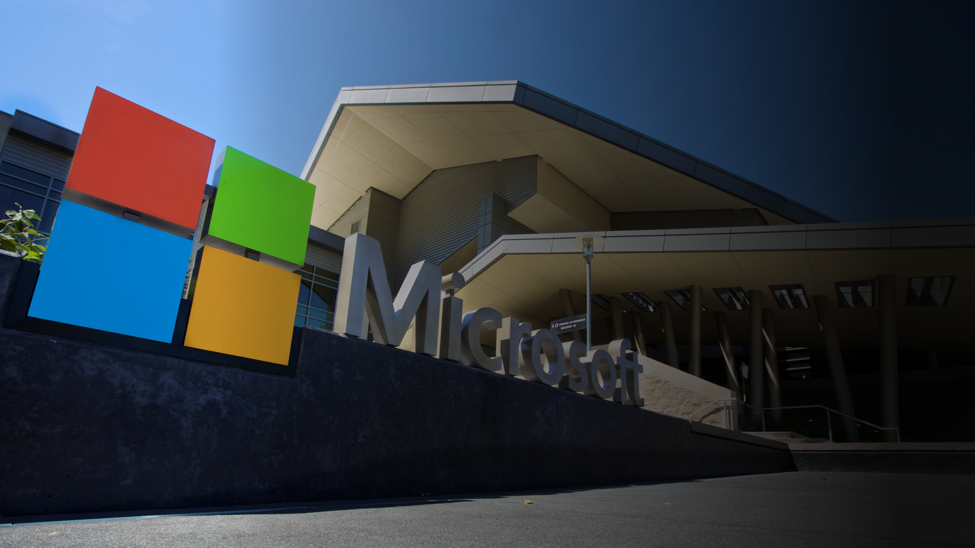
Thank you!
Notes:
“We are not going to stop making progress, or reverse it, so we have to recognize the dangers and control them.” – Steven Hawking

